Slide 1


Telecom Customer Churn Analysis
MODERN DATA ARCHITECTURES FOR BIG DATA I
Group 2

Slide 2



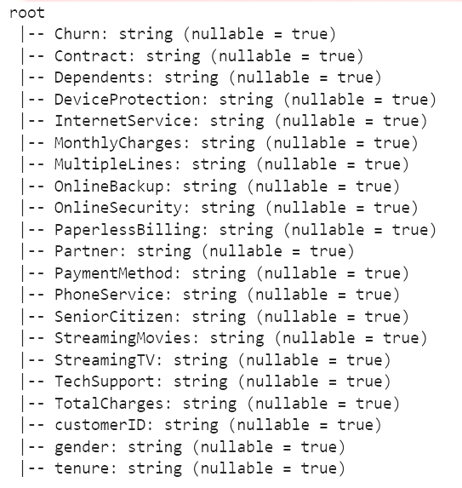
Data Source
Dataset obtained from a Coursera telecom customer churn case study.
Contains customer demographics, service features, account details, and the churn indicator (Yes/No).
Includes both categorical and numerical variables suitable for predictive modeling.
Provides a practical basis for analyzing churn behavior and building classification models.
Problem Context & Dataset Overview
Why This Matters
Customer churn is a significant challenge in the telecom industry, where retaining customers is more cost-effective than acquiring new ones.
The objective is to build a decision tree model to predict which customers are likely to churn.
The project focuses on identifying key churn drivers using customer demographics, service usage patterns, and account information.
Steps include data cleaning, feature engineering, model training, and performance evaluation.
The outcome supports proactive retention strategies and data-driven decision making.

Slide 3




Prepping the Landing Zone: Mock API-Based Ingestion
Why This Approach
What the Code Does
Loads the raw dataset from a CSV file using pandas.
Starts a lightweight Flask web server running locally.
Converts the entire DataFrame into a list of JSON records.
Exposes the dataset through an HTTP endpoint: GET /data → returns the CSV data as JSON
Acts as a mock source system, similar to how real applications expose data to other systems.
Mimics real systems that expose data via REST APIs
Lets tools like NiFi consume data programmatically
Turns a static CSV into a dynamic API-based data service
Aligns the project with modern, API-driven data architectures

Slide 4

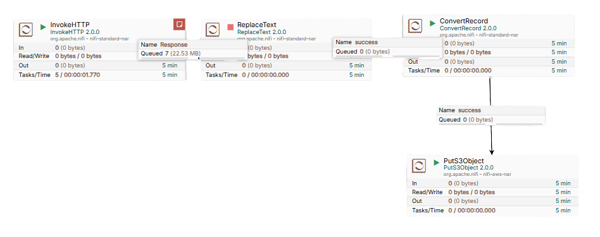
03
ConvertRecord
Transforms the cleaned JSON into structured CSV format using schema inference and record-based processing. (JsonTreeReader, CSVRecordSetWriter)
How the Ingestion Pipeline Works
04
PutS3Object
Writes the transformed CSV into the S3/MinIO landing zone using a date-based folder structure for organized storage.
(bronze/customer_experience/yyyy/MM/dd/data.csv)
A simple ingestion pipeline that pulls JSON data from a local API,
cleans the content, converts it into structured CSV,
and lands it in an S3 bucket (MinIO in this setup).
01
InvokeHTTP
Pulls raw JSON data from the Flask API endpoint at regular intervals, serving as the pipeline’s external data source.
02
ReplaceText
Cleans and normalizes the JSON by fixing invalid NaN values, ensuring the data can be parsed correctly downstream.

Slide 5




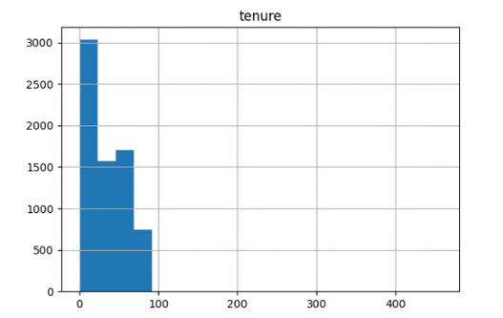
Data Preprocessing
Created a Spark session to efficiently process large datasets in a distributed environment.
Convert String Columns to Numeric
Validate Categorical Columns
All columns were initially strings.
Converted tenure, MonthlyCharges, and TotalCharges to double type for analysis and modeling.
Reviewed unique values across all categorical features.
Ensured they matched expected business logic
Exploratory Data Checks
Handle Missing Values
Plotted histograms of numeric columns to inspect distributions.
Identified and removed outliers (tenure) to avoid skewing the model.
Checked for missing entries across the dataset.
Imputed missing numeric values using mean imputation to maintain consistency.
imputer = Imputer(inputCols = col_with_missing_val, outputCols = col_with_missing_val).setStrategy("mean")

Slide 6
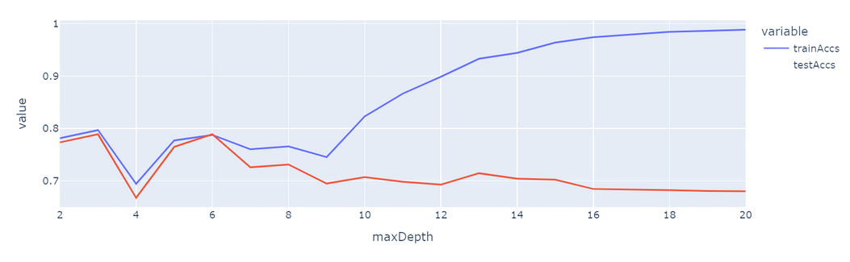
03
Model Accuracy & Hyperparameter Tuning
Evaluated model performance using AUC (Area Under the ROC Curve), which measures the model’s ability to correctly distinguish churn vs. non-churn.
The maxDepth parameter controls how complex the decision tree can become.
Small maxDepth → underfitting (model too simple).
Large maxDepth → overfitting (model memorizes training data)
Tested multiple maxDepth values and plotted train accuracy vs. test accuracy.
Identified the optimal maxDepth where test accuracy peaks while the gap between training and testing performance remains small.
Feature Engineering & Model Building
01
Vector Assembly
Used PySpark’s VectorAssembler to combine selected numeric and encoded categorical features into a single feature vector required by MLlib.
02
Decision Tree Model Training
Split the dataset into training and test sets.
Trained a DecisionTreeClassifier using the assembled feature vector and the churn label.

Slide 7
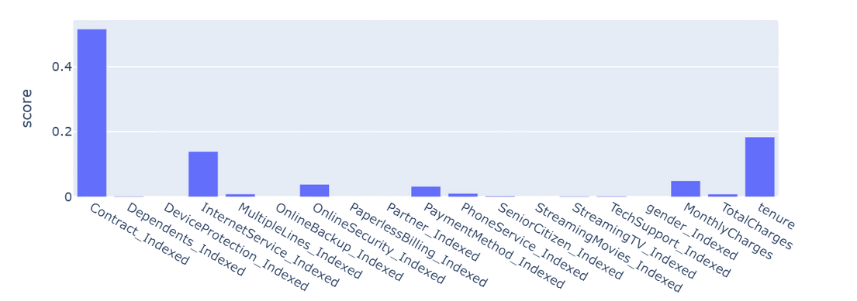
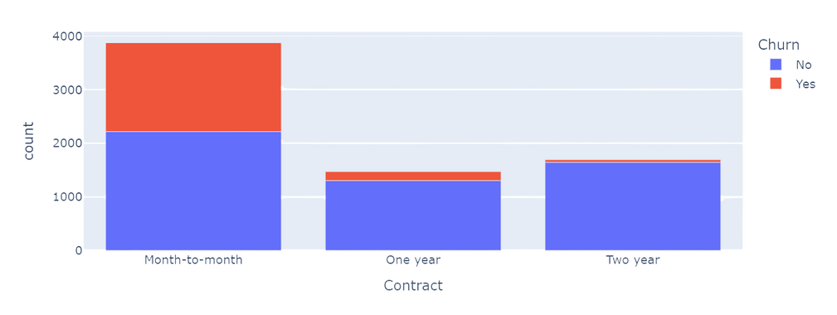
Insights from our analysis
We successfully trained a Decision Tree model that achieved ~80% accuracy on the test dataset.
This model enables the business to identify high-risk customers who are likely to churn and proactively target them with retention strategies.
Feature importance analysis shows that contract type is the strongest predictor of churn.
A deeper look reveals that monthly contract customers churn significantly more than those on yearly contracts.
Recommendation: Prioritize retention efforts for monthly-contract customers by offering incentives or converting them to longer-term plans through targeted campaigns and discounts.

Slide 8
Thank You
For Your Attention

